Slide 1

8th Grade Math: Pre-Algebra Unit 13, Lesson 3 Angle Relationships in Triangles Volume 2, pg. 279

Slide 2


Benchmark
MA.8.GR.1.5
Solve problems involving the relationships of interior and exterior angles of a triangle.
volume 2, pg. 279

Slide 3
Integrated Mathematical Thinking and Reasoning Standards
MA.K12.MTR.2.1 Demonstrate understanding by representing problems in multiple ways.
MA.K12.MTR.4.1 Engage in discussions that reflect on the mathematical thinking of self and others.
volume 2, pg. 279

Slide 4

Learning Targets
I can identify the relationships of interior and exterior angles of a triangle.
I can write and solve algebraic equations to solve mathematical problems involving angle relationships of triangles.
volume 2, pg. 279

Slide 5

Warm-Up
volume 2, pg. 279

Slide 6
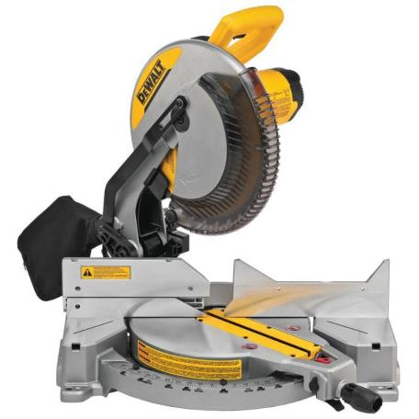
13.3.1 Warm-Up: Math Talks
Angle measures are often used in construction projects. Special saws, like the miter saw shown, are used to make precise cuts into wood and other raw materials.
What is something you notice about the miter saw?
What is something you wonder about the miter saw?
volume 2, pg. 279

Slide 7

Exploration
volume 2, pg. 280

Slide 8

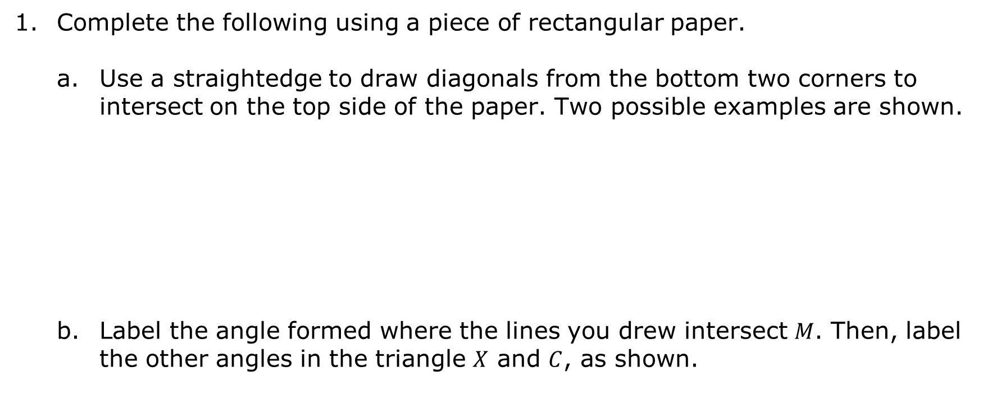
13.3.2 Exploration: Interior Angles of a Triangle
Complete the following using a piece of rectangular paper.
Use a straightedge to draw diagonals from the bottom two corners to intersect on the top side of the paper. Two possible examples are shown.
Label the angle formed where the lines you drew intersect $M$. Then, label the other angles in the triangle $X$ and $C$, as shown.
volume 2, pg. 280

Slide 9
These angles are called the interior angles of the triangle because they are inside the triangle.
Cut out the triangle.
Cut or tear the triangle so that each angle is separated. An example of where to cut is shown.
volume 2, pg. 280

Slide 10
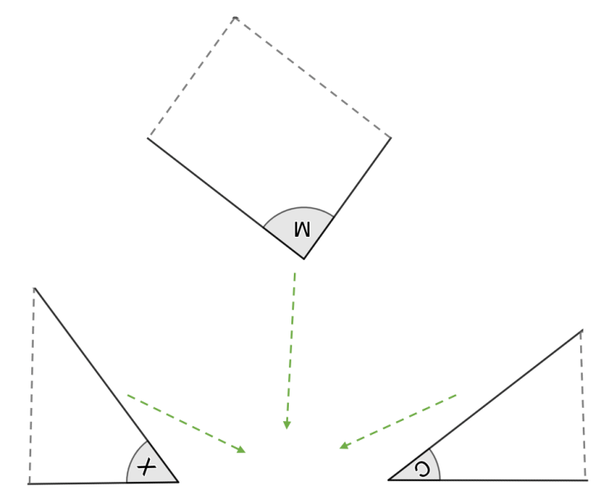
Rotate and slide the labeled angles to form a set of three adjacent angles. The image shows the beginning of this process with arrows indicating where the angles should continue to slide.
What do you notice?
Compare your findings with your partner.
volume 2, pg. 280

Slide 11


Complete the conjecture about the relationship of the three interior angles of a triangle.
Adjacent angles that form a straight line have a sum of
Based on the findings from the Exploration, the three interior angles of a triangle sum to
$90°$.
$180°$.
$360°$.
$90°$.
$180°$.
$360°$.
volume 2, pg. 280

Slide 12

Guided Practice
volume 2, pg. 281

Slide 13


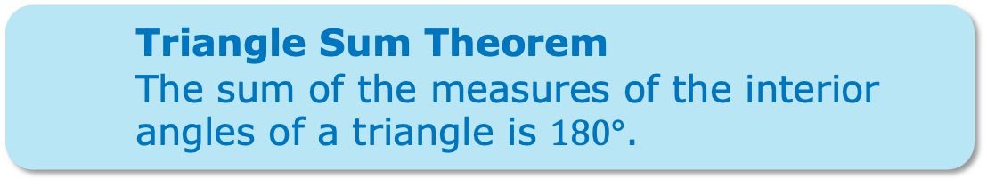
13.3.3 Guided Practice: Interior Angles of Triangles
The relationship of the interior angles of a triangle can be used to solve for unknown angle measures in a triangle.
Triangle Sum Theorem
The sum of the measures of the interior angles of a triangle is $180°$.
volume 2, pg. 281

Slide 14
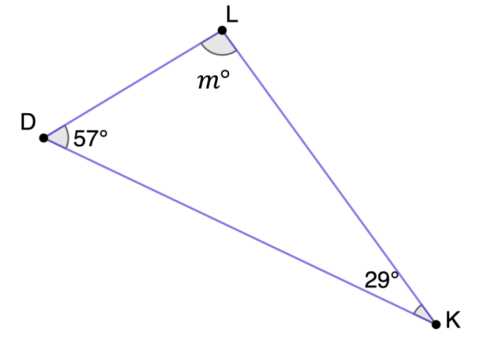

Triangle $LDK$ is shown.
Write an equation that can be used to find the measure of the unknown angle in the triangle.
Solve the equation to find the measure of $∠KLD$.
volume 2, pg. 281

Slide 15

Triangle $NGT$ is shown.
Write an equation that can be used to find the value of $x$.
Solve the equation.
Find the measure of $∠GTN$.
volume 2, pg. 281

Slide 16

Collaboration
volume 2, pg. 282

Slide 17

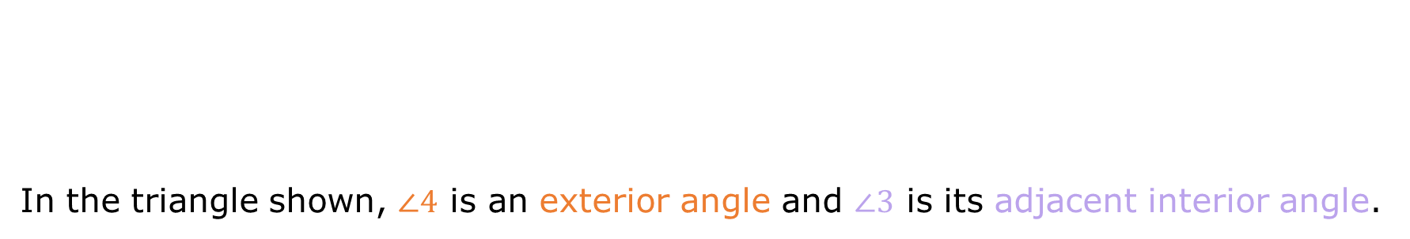
13.3.4 Collaboration: Exterior Angles of Triangles
In the triangle shown, $∠4$ is an exterior angle and $∠3$ is its adjacent interior angle.
An exterior angle is an angle created by extending one leg of a triangle.
volume 2, pg. 282

Slide 18
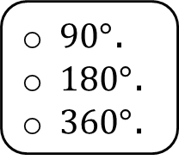
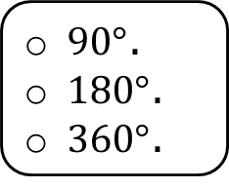
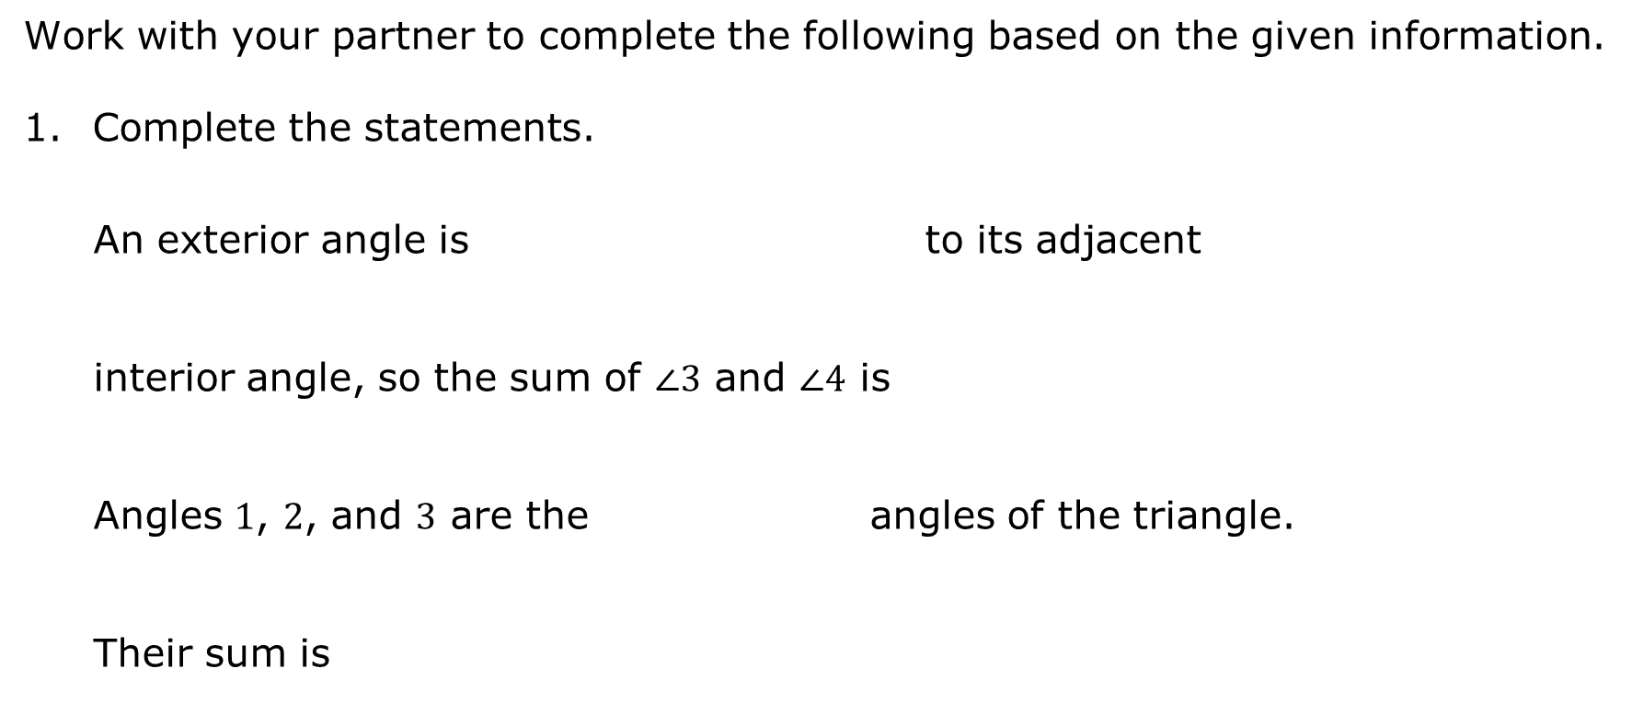
Work with your partner to complete the following based on the given information.
Complete the statements.
An exterior angle is to its adjacent
interior angle, so the sum of $∠3$ and $∠4$ is
Angles $1$, $2$, and $3$ are the angles of the triangle. Their sum is
complementary
supplementary
vertical
$90°$.
$180°$.
$360°$.
interior
exterior
$90°$.
$180°$.
$360°$.
volume 2, pg. 282

Slide 19
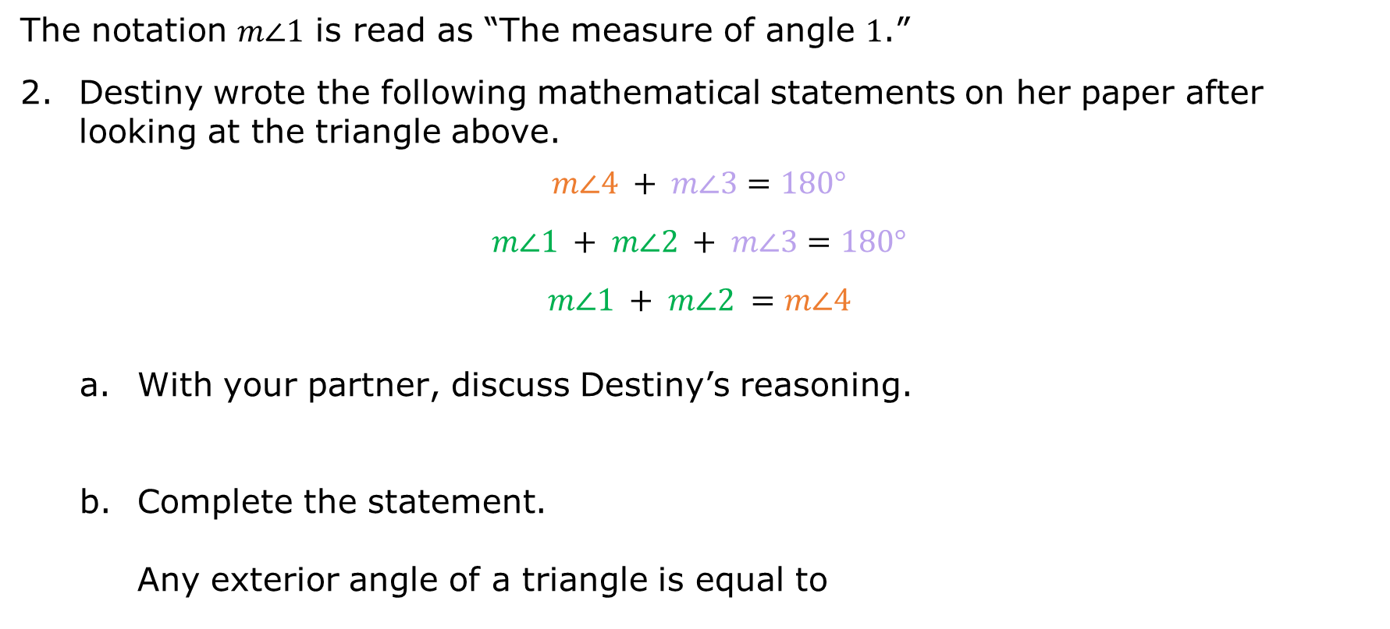
The notation $m∠1$ is read as “The measure of angle $1$.”
Destiny wrote the following mathematical statements on her paper after looking at the triangle above.
$$m∠4 + m∠3=180°$$
$$m∠1 + m∠2 + m∠3=180°$$
$$m∠1 + m∠2 =m∠4$$
With your partner, discuss Destiny’s reasoning.
Complete the statement.
Any exterior angle of a triangle is equal to
one of the interior angles of the triangle.
the sum of the two non-adjacent interior angles of the triangle.
volume 2, pg. 282

Slide 20
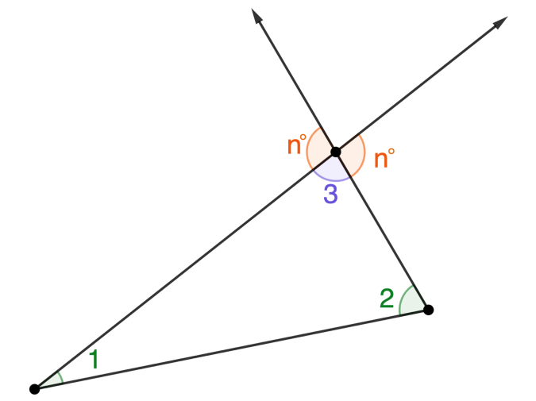

Every interior angle of a triangle has two possible exterior angles, depending on the side length that is extended. Consider the triangle shown with both possible exterior angles of $∠3$ labeled $n°$.
Discuss with your partner the angle relationship between both possible exterior angles of $∠3$.
volume 2, pg. 282

Slide 21
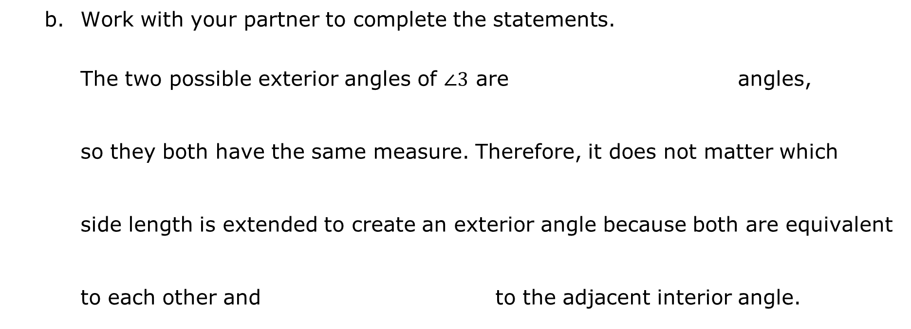
Work with your partner to complete the statements.
The two possible exterior angles of $∠3$ are angles, so they both have the same measure. Therefore, it does not matter which side length is extended to create an exterior angle because both are equivalent to each other and to the adjacent interior angle.
complementary
supplementary
vertical
complementary
supplementary
vertical
volume 2, pg. 283

Slide 22
Guided Practice
volume 2, pg. 283

Slide 23
13.3.5 Guided Practice: Exterior Angles of Triangles
The relationship of the exterior angles of a triangle can be used to solve for unknown angle measures in a triangle.
The measure of an exterior angle of a triangle is equal to the sum of the measures of the two non-adjacent interior angles of the triangle.
volume 2, pg. 283

Slide 24

Consider the diagram shown.
Find the measure of $∠YWX$.
volume 2, pg. 283

Slide 25

A figure is shown.
Write an equation that can be used to find the value of $y$.
Solve the equation.
volume 2, pg. 284

Slide 26

Wrap-Up
volume 2, pg. 284

Slide 27



13.3.6 Wrap-Up: Reflection
Circle the icon that best describes your understanding of each learning target listed in the table.
I could help
someone.
I need help.
I got it.
I can identify the relationship between interior and exterior angles of a triangle.
I can write and solve algebraic equations to solve mathematical problems involving angle relationships of triangles.
volume 2, pg. 284

